Slide 1
FEATURE ENGINEERING
JOSHUA NATHANAEL B230993EP

Slide 2
BASICS RULES OF TIME SERIES
DATA MUST BE STATIONARY
FUTURE DATA MUST BE HIDDEN FROM PAST
ISSUES CAUSED BY THESE RULES:
CANNOT USE STANDARD SCALER , BOX-COX OR ANY STATISTICAL TRANSFORMATION BASED ON DISTRIBUTION
CANNOT USE STANDARD GRID SEARCH CV , MUST USE TIME SERIES VERSION
CAN NOT USE DIMENSIONALITY REDUCTION LIKE PCA

Slide 3
BASICS COMPONENTS OF TIME SERIES DATA
1. A TIME SERIES DATA IS MADE OF THREE COMPONENTS : TREND , SEASONALITY AND RESIDUALS
2. IF THE ORIGINAL SERIES IS SUM OF THESES THREE COMPONENTS ITS ADDITIVE , IF ITS A PRODUCT THEN ITS MULTIPLICATIVE

Slide 4
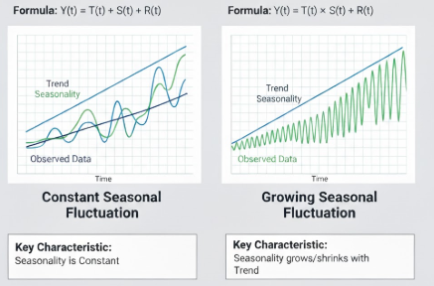

Slide 5
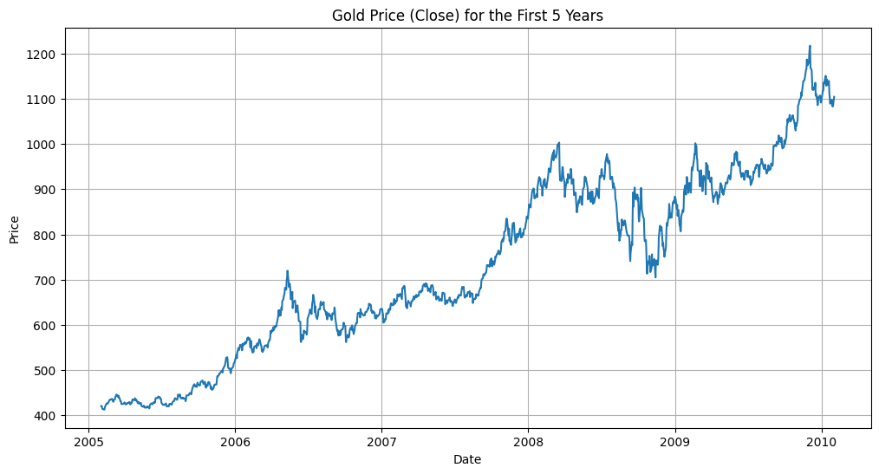

Slide 6
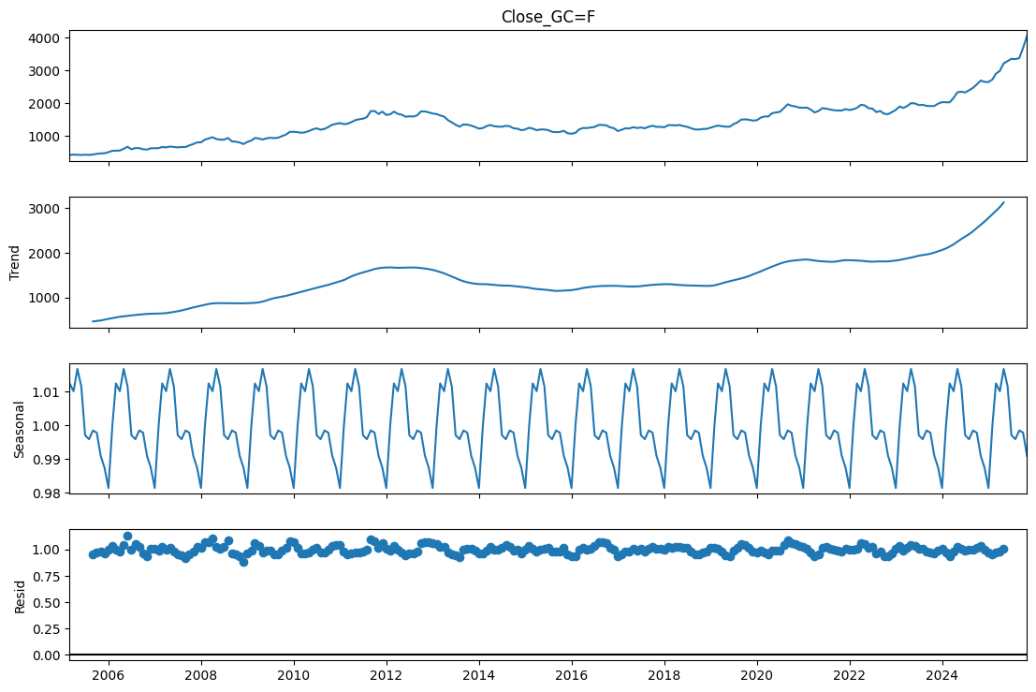

Slide 7
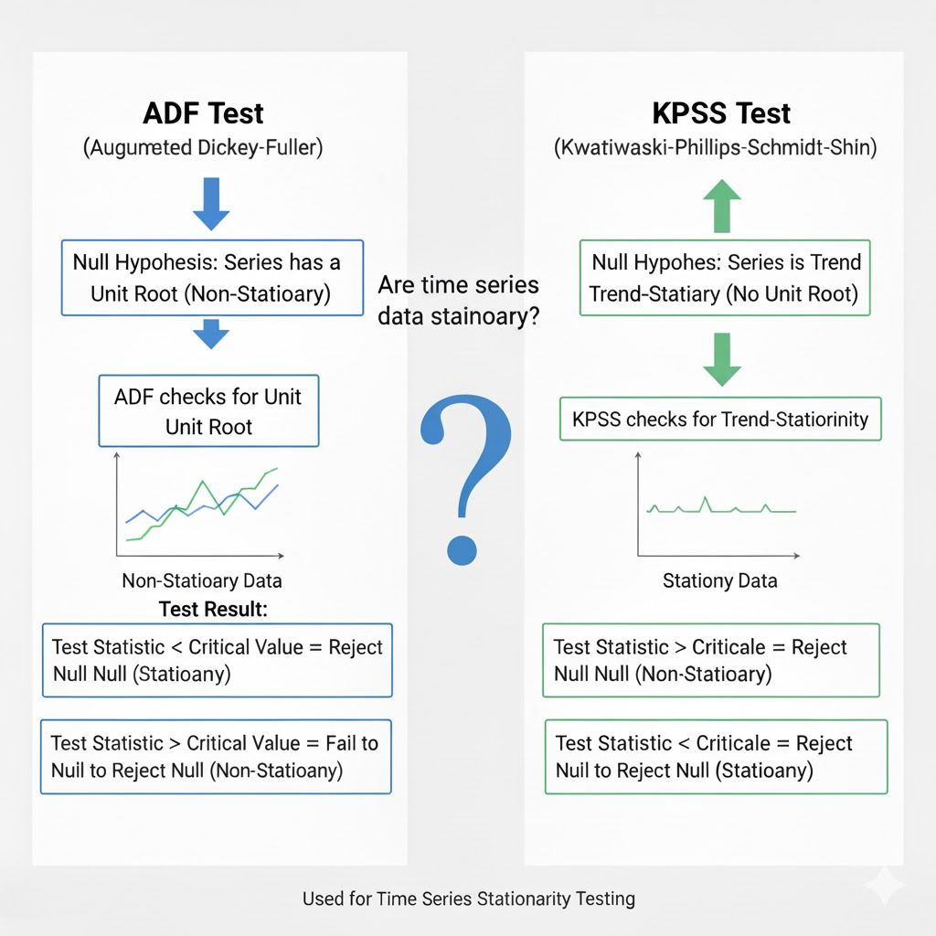

Slide 8
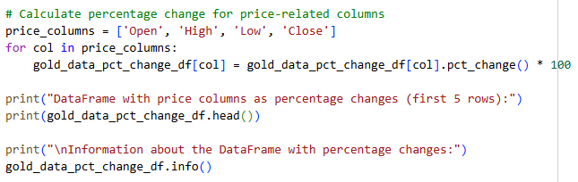
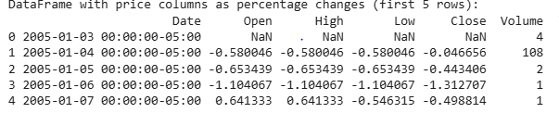

Slide 9
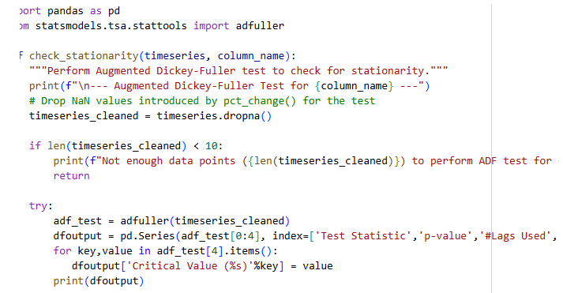
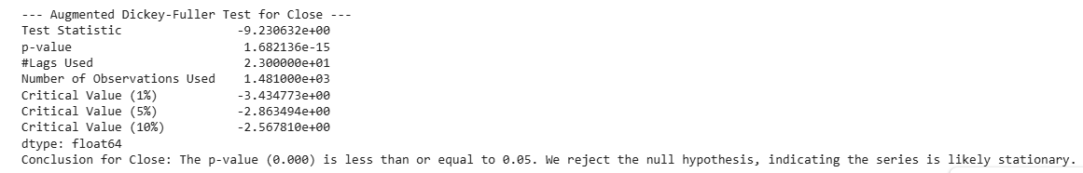

Slide 10
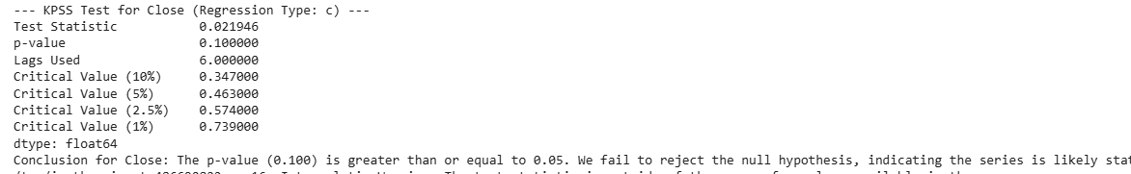

Slide 11
FEATURES CREATED
ACTION LAGS , SINCE THE PAST ACTION IS THE RESULT OF ALL THE INFLUENCES IT CONTAINS ALL THE DATA WITHIN ITSELF WE USE CERTAIN ACTIONS LIKE PAST DAY ACTION , HOLD FREQUENCY , PAST 5 DAY ACTION SO ON
GOLD PERCENTAGE RETURNS FOR 3 , 4 ,5 DAYS
WE USED SILVER, SP CLOSE PERCENTAGES AND THEIR CORRELATION WITH GOLD TOO
VOLUME PERCENTAGE/LOG CHANGE
MOMENTUMS

Slide 12
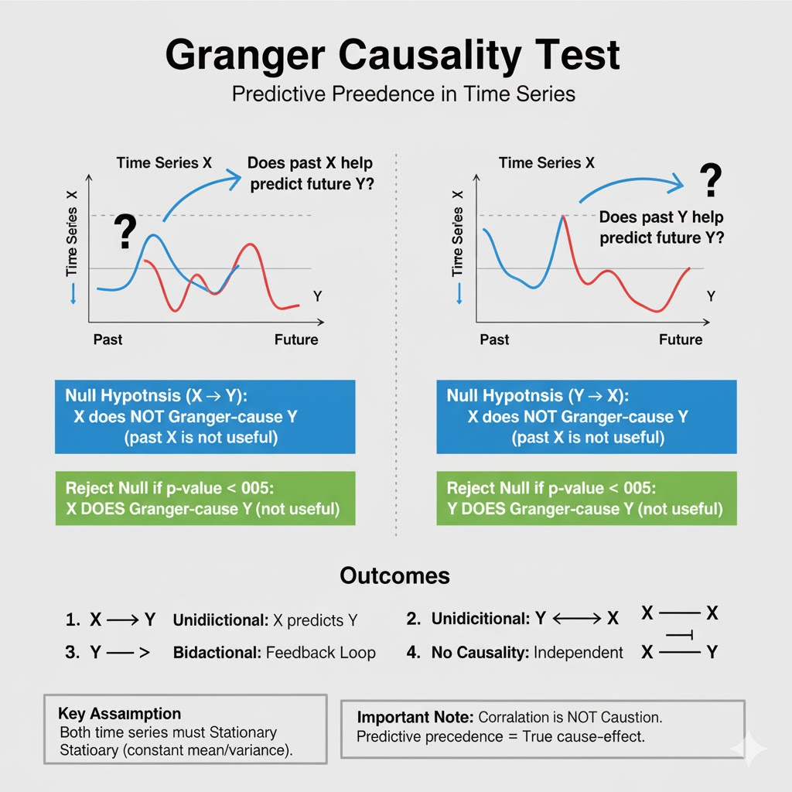

Slide 13
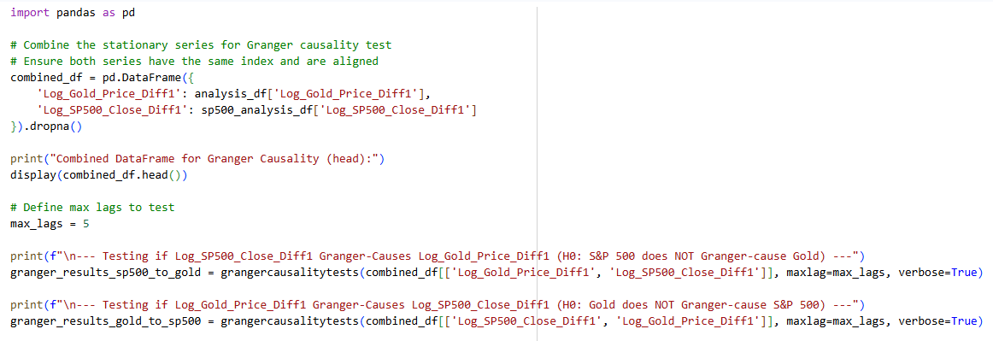

Slide 14
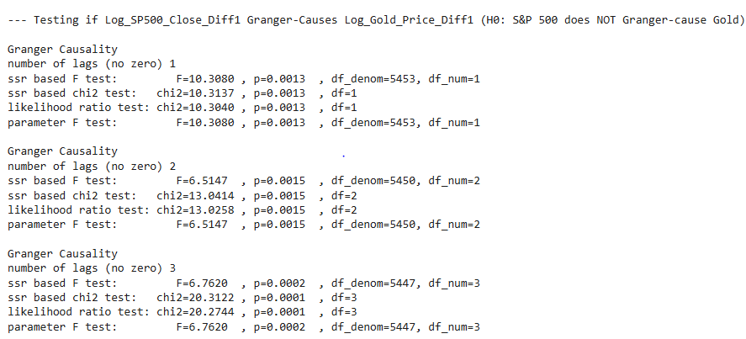
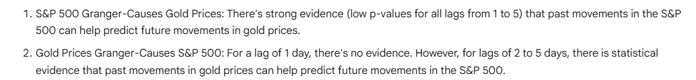

Slide 15
